Slide 1
Data Stuctures and Algorithms
Dr. Fidaa Abed

Slide 2
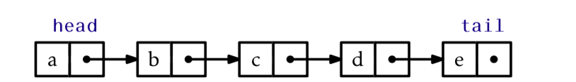
Linked Lists

Slide 3
Linked Lists
Advantages
add and remove are efficient
Linked Lists are dynamics
Disadvantages
set(I,x), get(i) are not efficient operations any more

Slide 4
Singly Linked Lists
Every node points to the next node.
The last node points to null.
We have head pointing to the first node.
We have tail pointing to the last node.

Slide 5
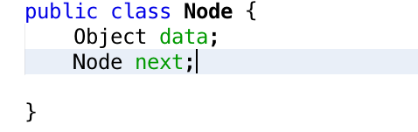
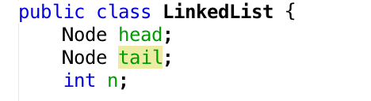
Singly Linked Lists

Slide 6
Stack as a link list
push(x) at the head of the linked list
pop() the head of the linked list

Slide 7
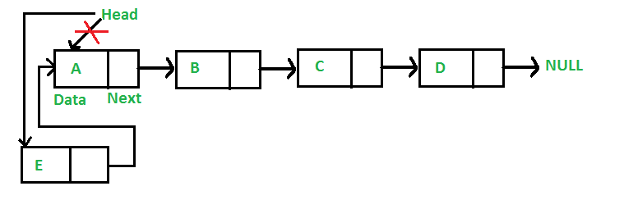
push(x)

Slide 8
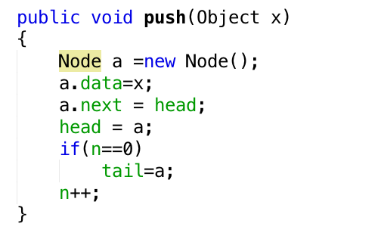
push(x)

Slide 9
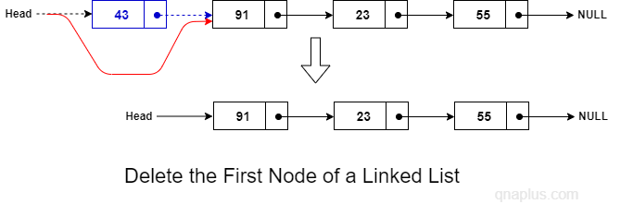
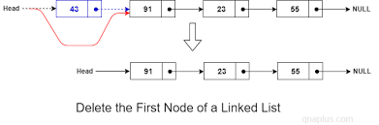
pop()

Slide 10
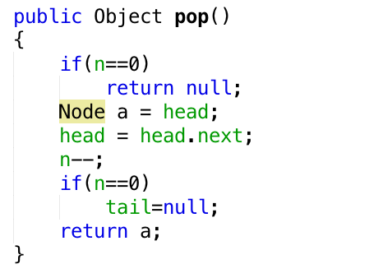
pop()

Slide 11
Excercise
Implement Queue operations in the linked list
add(x)
remove()

